Slide 1

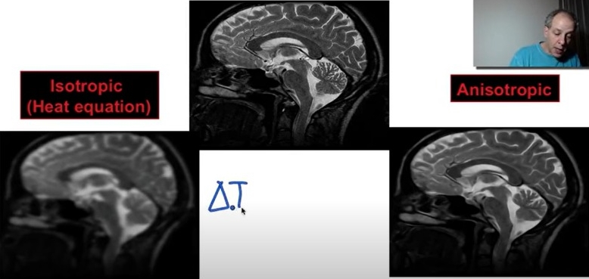
APL 405 Image Denoising using PINN
NOISY IMAGE
ISOTROPIC DIFFUSION
ANISOTROPIC DIFFUSION
Group 10 - Moirangthem Dinachandra
Ishaan Govil
Hemali Priyadarshi
Nisha Saha
Revanth Vasireddy
Darshan Rakhewar

Slide 2
Problem Statement
We present the potential of applying physics-informed neural networks for solving nonlinear diffusion equation modeled for removing unwanted noise in digital images.
Specifically, we investigate how to extend the methodology of PINN to solve the forward problem in relation to the nonlinear diffusivity and the Perona-Malik equation. We have also implemented this model by deducing it’s FDM to run a comparison.

Slide 3

Addressing the problem with isotropic diffusion equation. Isotropic diffusion taking a constant differential function(c = constant) using PINN
Linear diffusion (heat) equation solve the image denoising problem. Let u₀ be a noisy image in the domain Ω,
$$\frac{∂u}{∂t}=div(c∇u)$$
With the initial condition that u(x, y, 0)= u₀(x, y), t∈[0,T]
defines an isotropic diffusion model for image denoising.
The evolving image - u(x, y, t) ∈ $R^{2}$× [0, T]
u(x, y, t)=(G_{√2t} ∗ u₀)(x, y),
where, G_{σ}(x, y) denotes the 2-D Gaussian kernel, and the operation ′∗′ is the convolution operation.
This heat equation removes the noise, but it generates sequentially more and more blurred images with each iteration, also it performs blurring of the features of importance such as edges leading to a barely recognizable image.

Slide 4
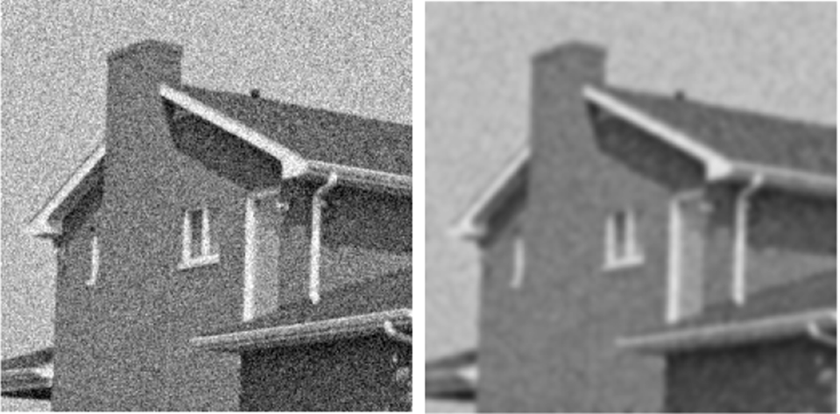
Isotropic approach example
NOISY IMAGE
LINEAR DIFFUSION EQUATION
The input image is blurred throughout including the edges which leads to the important features such as edges being blurred as well thus making the processed image even more unclear than before.

Slide 5
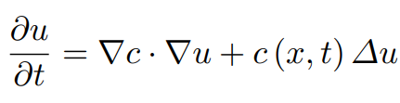
Perona-Malik Equation and Anisotropic diffusion
The idea behind the Perona-Malik equation is to modify the heat equation by adding the diffusivity coefficient depending on space activity in the given part of a picture, measured by the norm of the local picture gradient.
For small gradient norm (homogeneous regions) large values of the diffusivity are expected, to perform stronger smoothing. In regions with big gradient norm (inhomogeneity) smaller diffusivity is expected, to slow down the diffusion process and protect delicate image features.

Slide 6
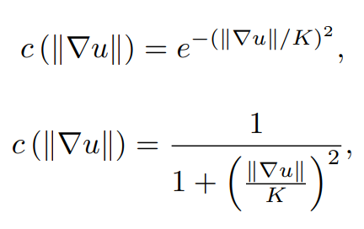
Perona-Malik Equation and Anisotropic diffusion
Perona-Malik coefficient (c) controls the rate of diffusion and has been chosen as a function of the signal gradient so as to preserve edges in the signal.
Choice of c :
• Inside the homogeneous region of the image where the magnitude of the gradients is weak, the above equation should perform isotropic smoothing.
• Near the regions’ boundaries in the image, the smoothing is stopped, and sharp details preserve in the restored image.
Perona & Malik suggested two functions as the diffusion coefficient:

Slide 7

We shall discuss about how we solved the PDE’s with two different approaches namely FDM and PINN, and later run a comparison between their respective results.
TODAY’S AGENDA

Slide 8

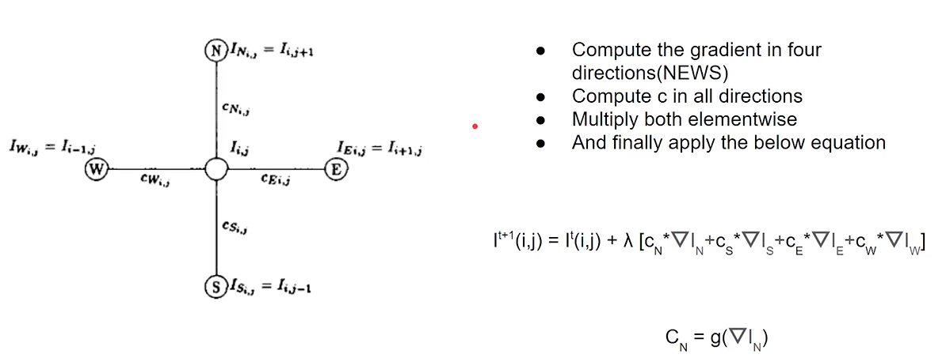
Methodology -FDM
This FDM model is obtained from the standard PM equation by replacing the ordinary derivative with a finite derivative.
Hence the Perona-Mallik equation in a simplified manner can be represented as follows -

Slide 9
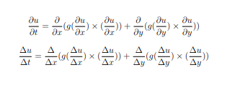
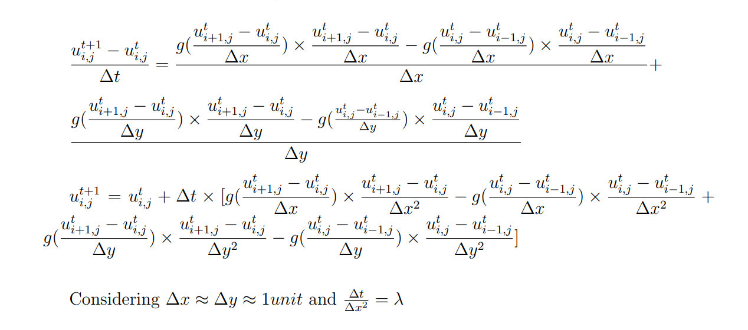
FDM Derivation

Slide 10
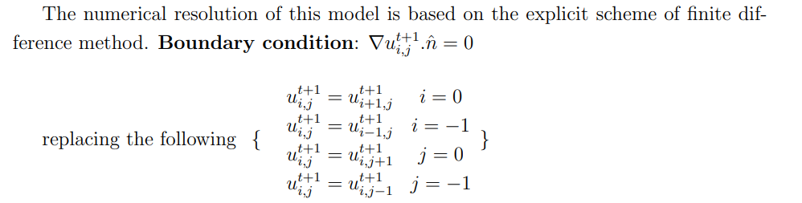
FDM Derivation
FDM Boundary condition:

Slide 11
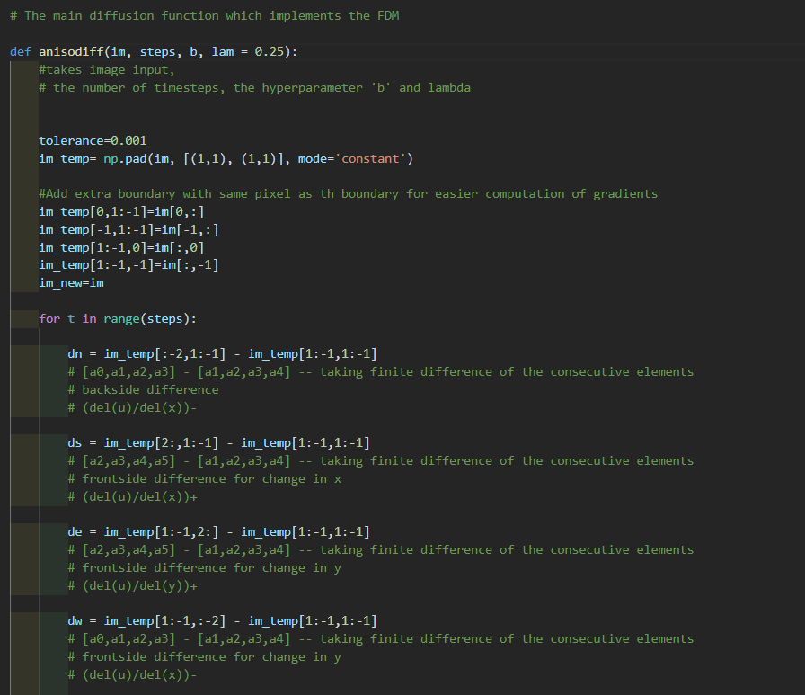
Methodology -FDM

Slide 12
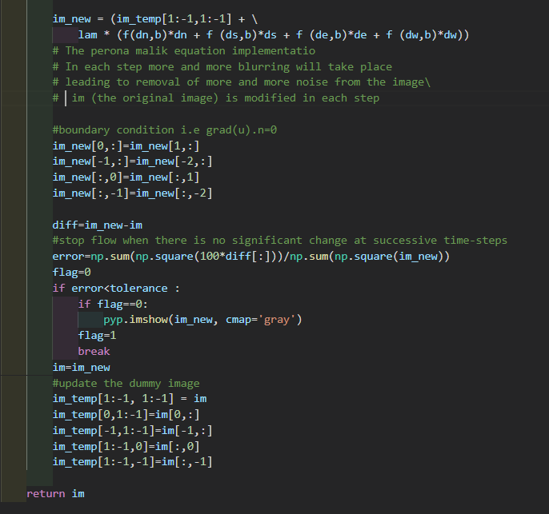
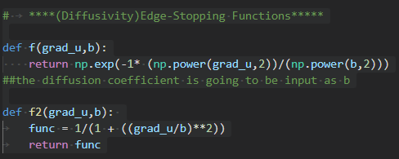
Methodology -FDM

Slide 13
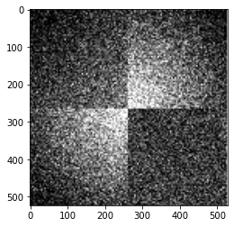
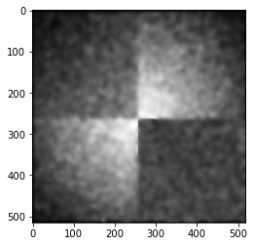
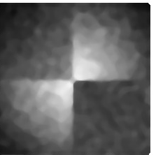
Results -FDM
PM MODEL FOR DENOISING WITH FDM(DENOISED + PRESERVED EDGES)
ORIGINAL IMAGE (NOISY)
GAUSSIAN FILTER FOR DENOISING (BLURRED EDGES)

Slide 14
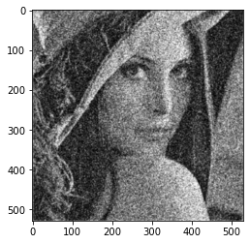
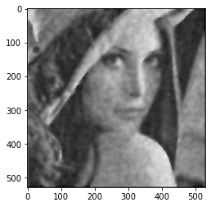
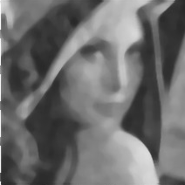
Results -FDM
PM MODEL FOR DENOISING
WITH FDM (DENOISED + PRESERVED EDGES)
ORIGINAL IMAGE (NOISY)
GAUSSIAN FILTER FOR DENOISING (BLURRED EDGES)

Slide 15
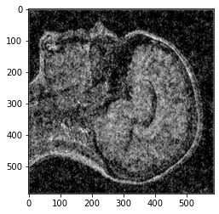
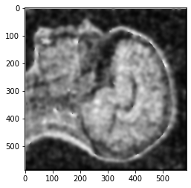
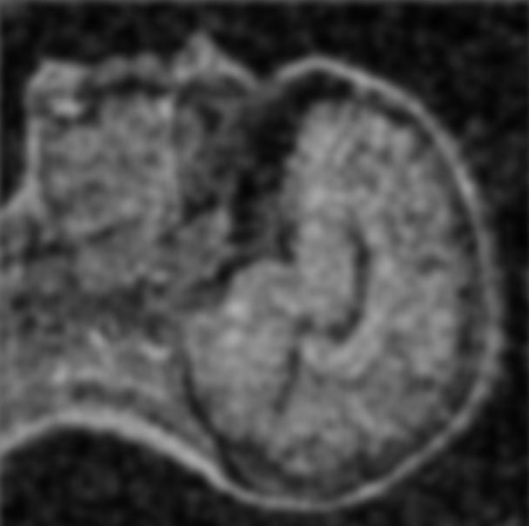
Results -FDM
PM MODEL FOR DENOISING WITH FDM(DENOISED + PRESERVED EDGES)
ORIGINAL IMAGE (NOISY)
GAUSSIAN FILTER FOR DENOISING (BLURRED EDGES)

Slide 16
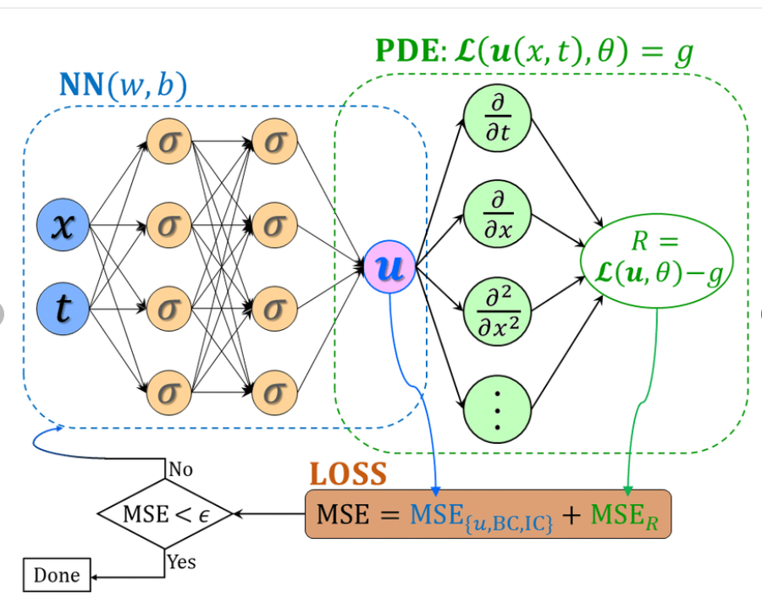
Methodology - PINN
WHAT IS PINN – physics-informed neural networks (PINNs) leverage governing physical equations in neural network training i.e. PINNs are designed to be trained to satisfy the given training data as well as the imposed governing equations. Potentially, an accurate solution of partial differential equations can be found without knowing the boundary conditions. Therefore, with some knowledge about the physical characteristics of the problem and some form of training data (even sparse and incomplete), PINN may be used for finding an optimal solution with high fidelity.
PINNs allow for addressing a wide range of problems in computational science and represent a pioneering technology leading to the development of new classes of numerical solvers for PDEs. In our project we would be making use of PINN’s to solve the well-known Perona-Malik equation and making use of it in the field of image processing.

Slide 17
Methodology – INPUT/OUTPUT
The inputs to our model consists of X , Y and T where :-
Input of the neural network are 3- 4D arrays covering each permutation of x, y, t as its element when viewed at different indices of size (n x n x m), where m represented the no of time steps at which we want to discretize the time frame , and assuming that the image is represented as an array of pixels of size n x n,
where the corresponding index entries at a particular index represent one specific pixel in space (specific x and y) at a particular instant of time(specific t).
Output is the ndarray containing each predicted u(x, y, t) for each corresponding (x, y, t) at the same index and is fount using the f.eval(x_input, y_input, t_input) function once the model has been trained.

Slide 18
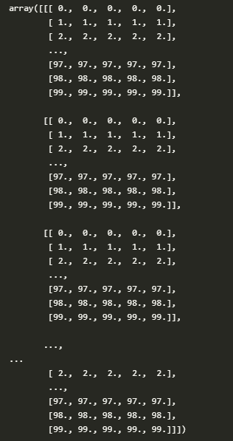
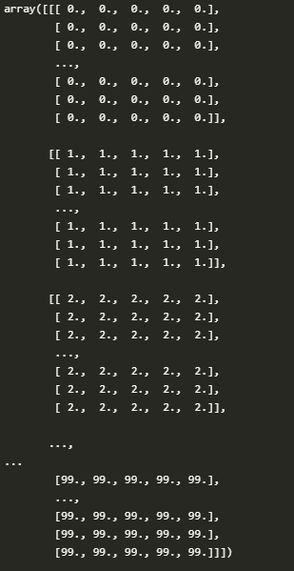
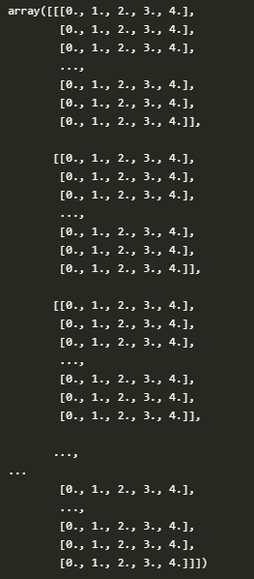
Sample input
x_data
y_data
t_data

Slide 19

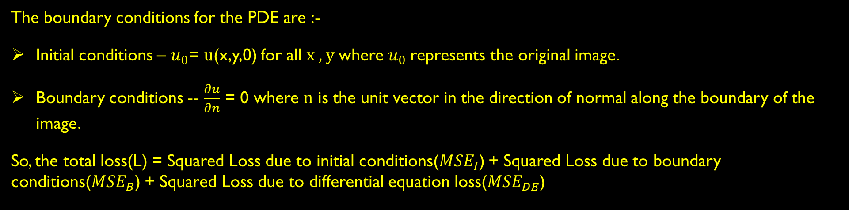
Methodology – PDE and Boundary conditions
The equation we are trying to solve is –
where $g\left(s\right)= \frac{1}{1+ s^{2}}$ and u is a function of x , y and t.
The boundary conditions for the PDE are :-
Initial conditions – $u_{0}$= u(x,y,0) for all x , y where $u_{0}$represents the original image.
Boundary conditions -- $\frac{∂u}{∂n}$ = 0 where n is the unit vector in the direction of normal along the boundary of the image.
So, the total loss(L) = Squared Loss due to initial conditions(${MSE}_{I}$) + Squared Loss due to boundary conditions(${MSE}_{B}$) + Squared Loss due to differential equation loss(${MSE}_{DE}$)

Slide 20
Implementation
We are making use of the SciANN library to implement our PINN neural network since it is more convenient to calculate the derivatives and specify the initial and boundary conditions in the SciANN framework.
We are also performing noise cleaning using the Finite difference method as described above so as to get a good estimate of our PINN model by comparing the processed image from the FDM and the PINN.
Making use of the SciANN inbuilt math.diff function we would be calculating the boundary and the differential equation losses and then use these losses to train the weights of the neural network so as to get a more accurate solution to the differential equation(u) which hopefully has lesser noise as compared to the original image.
And since our diffusion coefficient is non-uniform and an inversely dependent on the concentration gradient instead. Hence the blurring taking place at the edges(places where the pixel intensity changes abruptly) is very less as compared to the other areas and so we would get a non-uniformly diffused image.

Slide 21
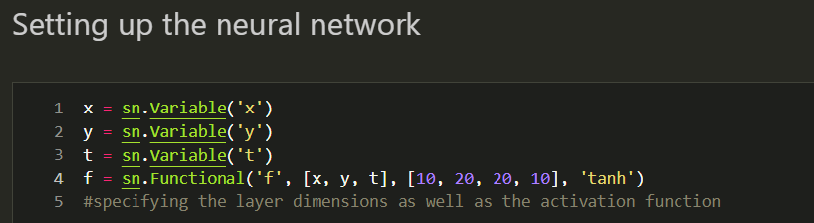
PINN model using SciANN
The neural network contains three inputs in the input layer(x, y, t).

Slide 22
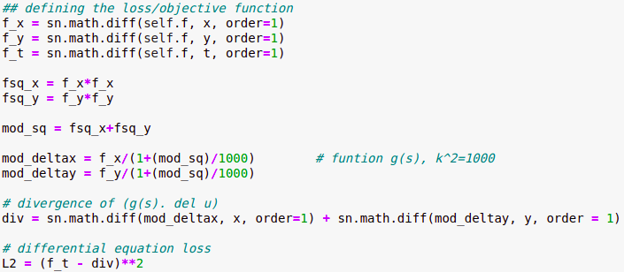
PINN model using SciANN
Differential Equation Loss:
Calculated using the differential equation -
Here, f_x, f_y, f_t are the derivatives of the output function with respect to x, y and t respectively and div is the divergence of f with respect to the space co-ordinates x and y.

Slide 23
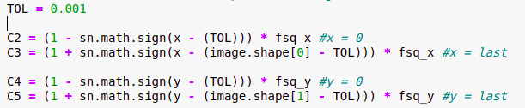
PINN model using SciANN
Boundary loss:
Partial derivative of the function w.r.t normal at the boundaries is zero.
Here, x = 0 and x = last indicates the left and right side boundary of the image and y = 0 and y = last indicates the lower and upper side boundary of the image
Initial loss:
The initial loss is taken care of, when we give an array containing actual image in the parameter while training.

Slide 24

The model :
This is the model. It contains the initial loss as d1 and other losses in d2.
Training the model :
To train the model we make use of SciANN.train function which takes as arguments –
The SciModel defined above (m)
The input data i.e x_data, y_data and t_data
The original image, so as to calculate the initial losses.
The learning rate
The no of epochs/iterations to be done

Slide 25
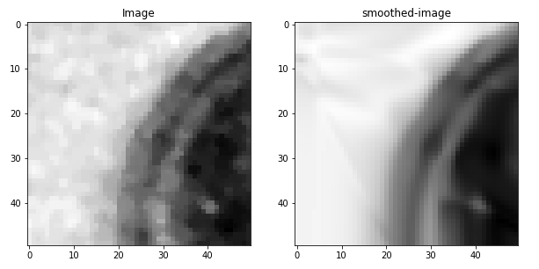
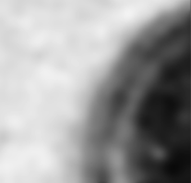
Results
PINN
FDM
Inference - As can be seen the PINN model is working better than the FDM implementation as it is giving a more cleaner and less noisy image. Also it takes care of the edges as we can see that the diffusion taking place at the edges is much less as compared to other parts of the image. This was expected when using anisotropic diffusion in our PINN model.

Slide 26
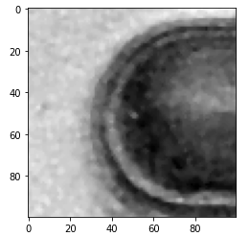
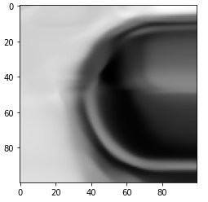
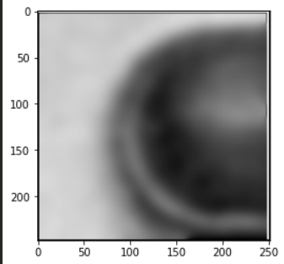
Now, let’s test our model with more complex images, like the MRI image of the brain to see how it performs…
Original Image
PINN result
FDM result
Again, we can see that the result of our PINN model is better than the traditional FDM approach in the sense that the blurring takes place non-uniformly at the edges and the interior of the image unlike in FDM.

Slide 27
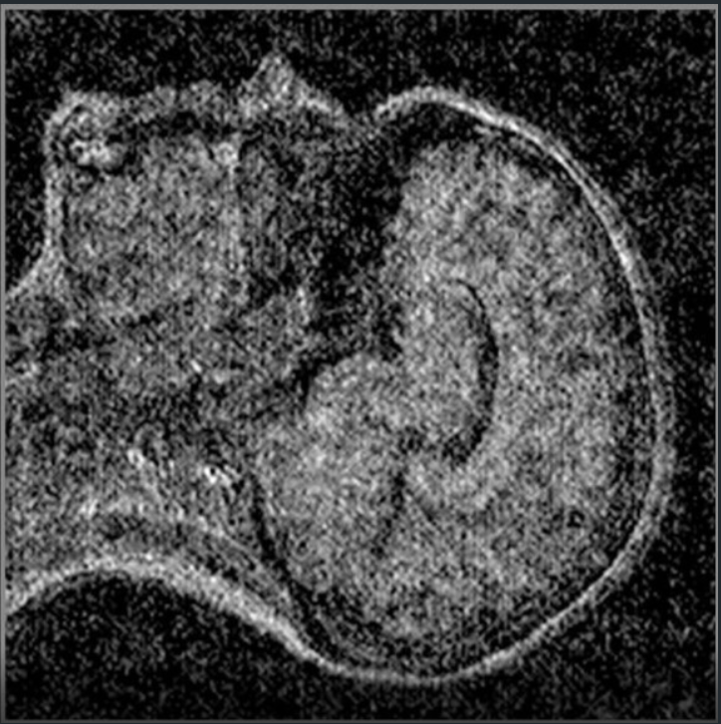
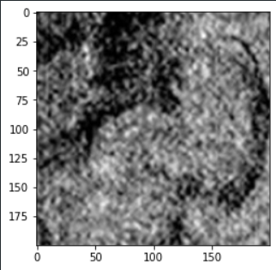
The 600x600 Original Image
The part of the image of we are working on
Here, we extract a part of the MRI brain image (one 9th of the image to be precise from the center of the image) and analyze it using our PINN model as well as the traditional FDM model.

Slide 28
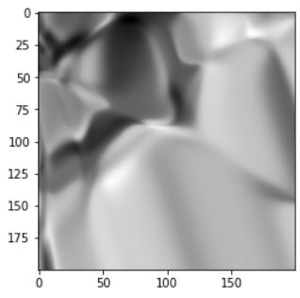
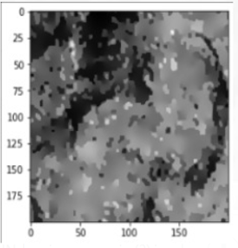
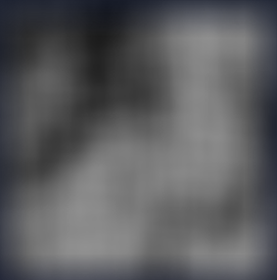
PINN Result
FDM result
Conventional Gaussian filters
The above result was produced by considering the time interval of 10 units and iterating over a 100 times for both the PINN and the FDM models.
From the results, we can conclude that the PINN result is much more cleaner and captures the texture of the brain as well in comparison to the FDM result which looks rather random and noisy.

Slide 29
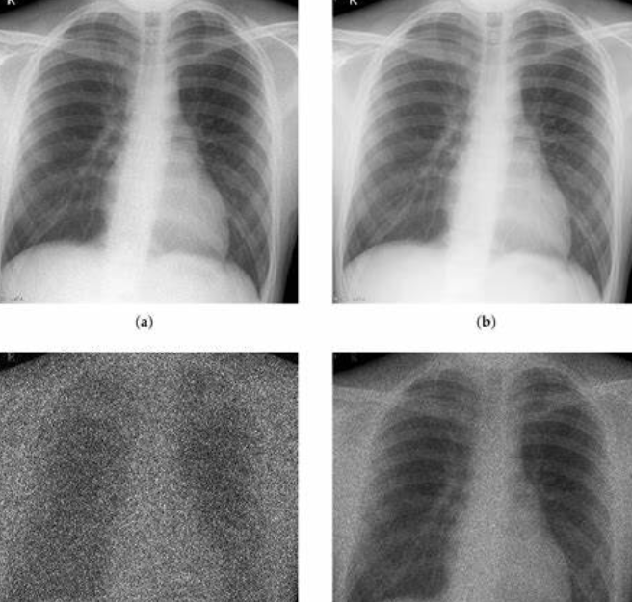
Future works
While acquisition and transmission of images, all recording devices have physical limitations and traits which make them prone to noise.
Noise manifests itself in the form of signal perturbation leading to deterred image observation, image analysis and image assessment. Image denoising is fundamental to the world of image processing.
Thus any progress made in image denoising forms a stepping stone in the understanding of image processing and statistics.
To extend our model to even more detailed images we would need to implement multi-threading as well as make use of the Graphical Processing Unit so that the operations taking place our faster and the no of iterations we can run our model on also increases thus producing better results.

Slide 30
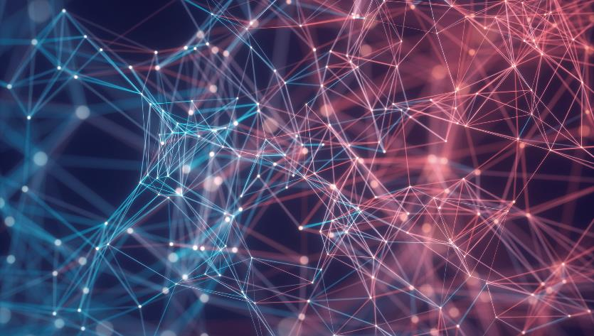

Thank You
References
•Perona-Malik equation and its numerical properties
•Adaptive Finite Element Method for Image Processing
•A least squares support vector regression for anisotropic diffusion filtering

